Slide 1



SAR Image Classification Using Few-shot Cross-domain Transfer Learning
Mohammad Rostami, Soheil Kolouri, Eric Eaton, Kyungnam Kim
© 2019 HRL Laboratories, LLC

Slide 2
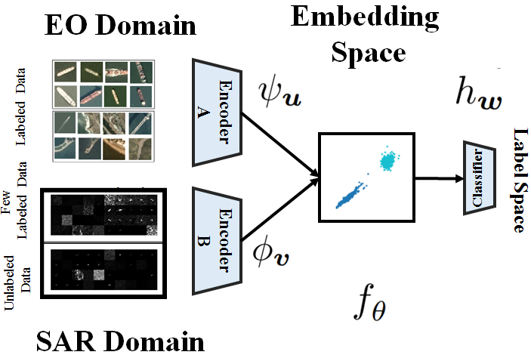
Summary
We develop a method to train deep networks for SAR domain problems, where labeled data is scarce.
Our idea is to transfer knowledge from EO domain, where it is easy to collect labeled data.
We learn an invariant embedding space, where the distributions of both domains are aligned class-conditionally
© 2019 HRL Laboratories, LLC

Slide 3
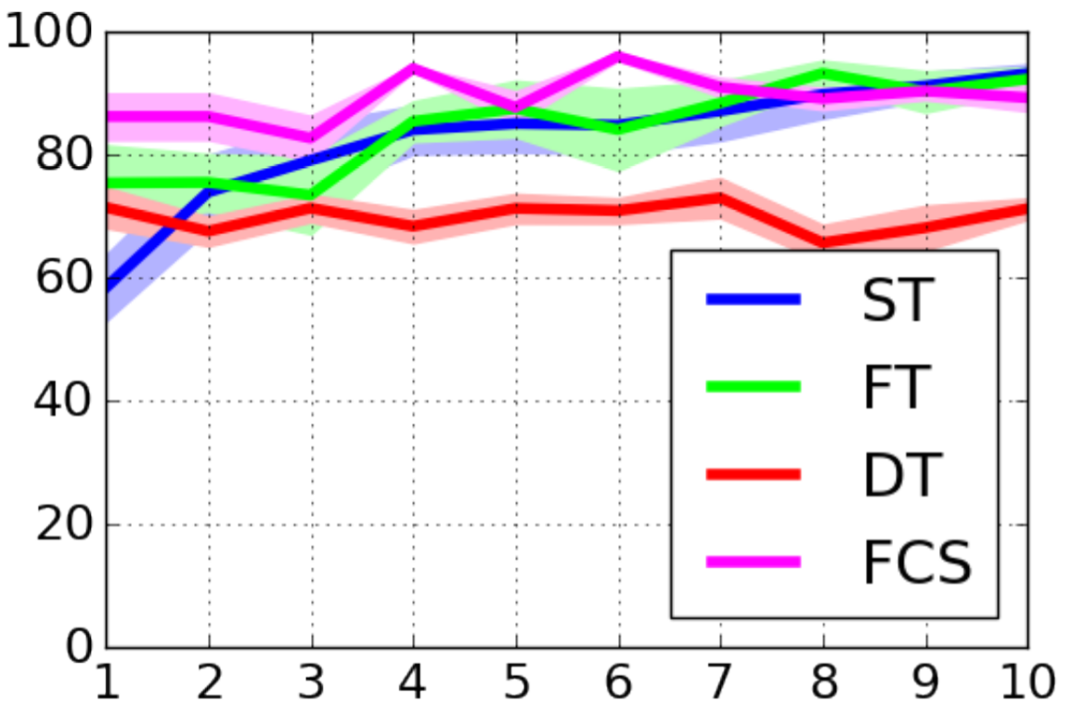
Results
We compare our results (Few-shot SAR image classification) against:
Supervised training (no knowledge transfer)
Fine tuning (prior methods)
Direct transfer
In the problem of SAR ship image classification
© 2019 HRL Laboratories, LLC

Slide 4
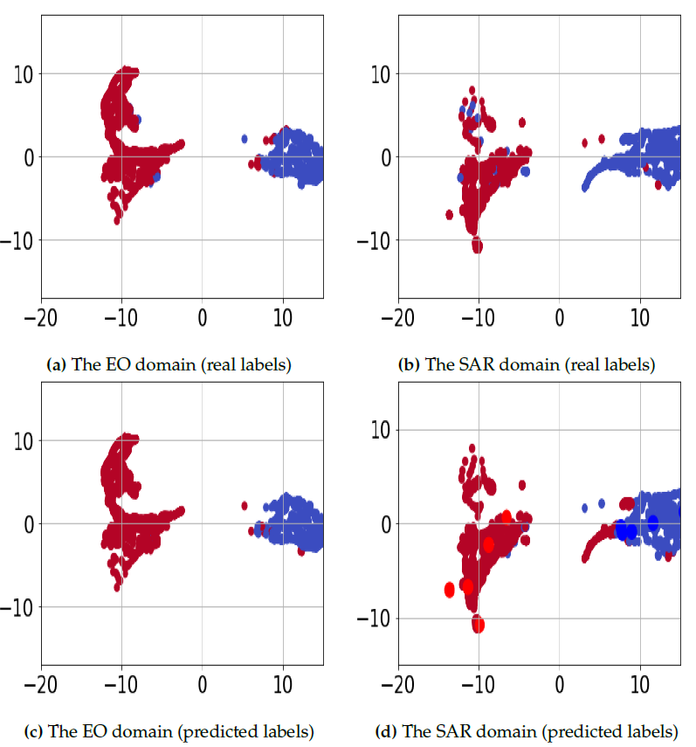
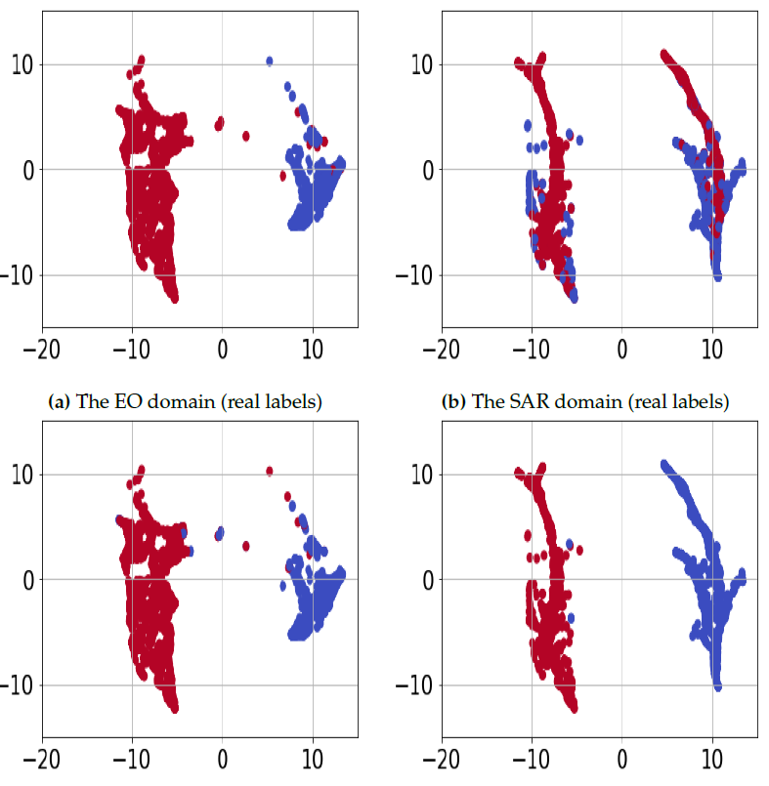
Results
t-SNE visualization of data in the embedding space
Ablation Study
© 2019 HRL Laboratories, LLC

